Slide 1
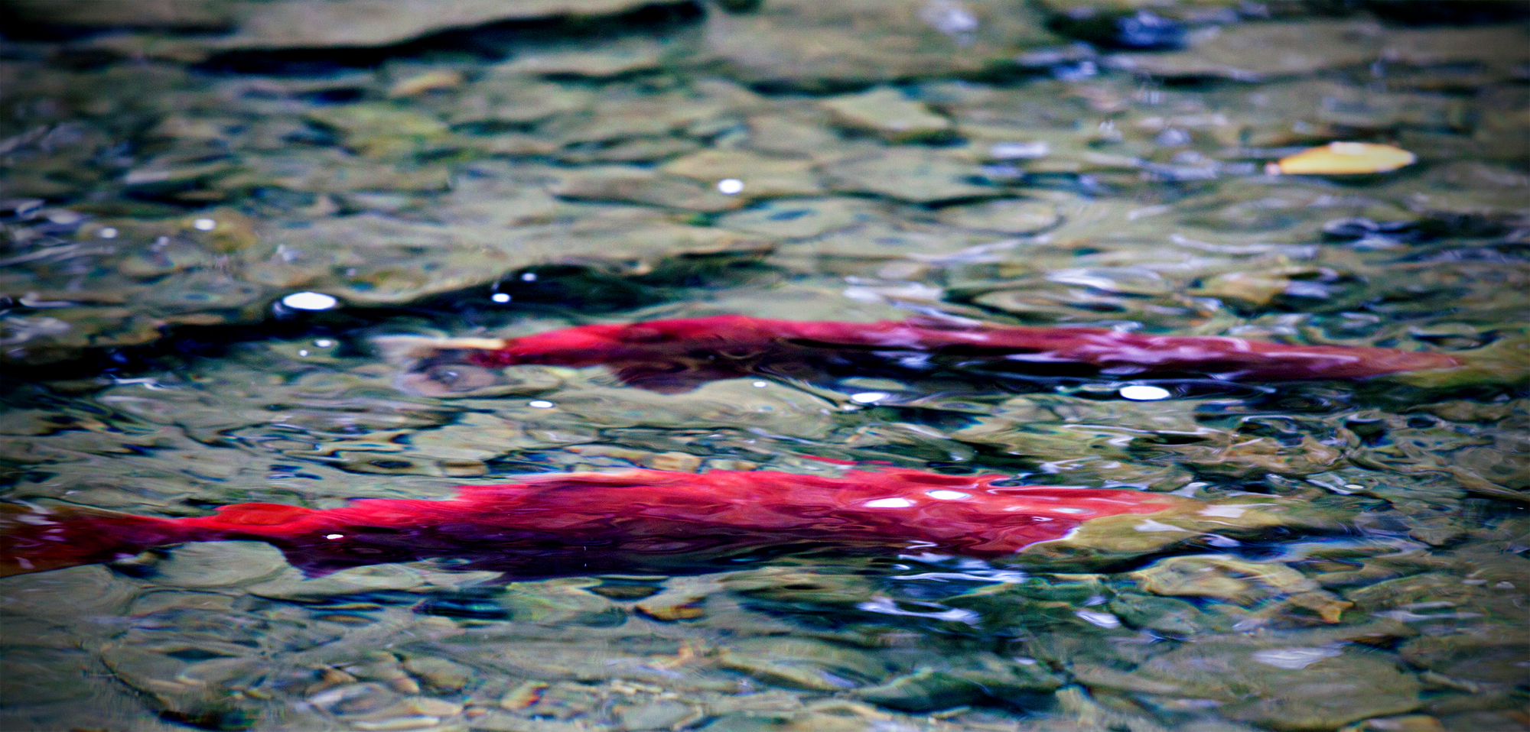
Delving Into the Effects of Synthetic Estrogen on Pacific Salmon in the Fraser River
Riley Hun
Riley Hun
Teresa Lawson
Harneet Dhami
December 7th 2012

Slide 2
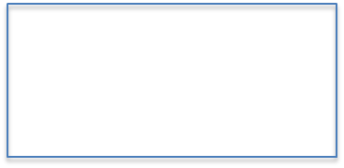
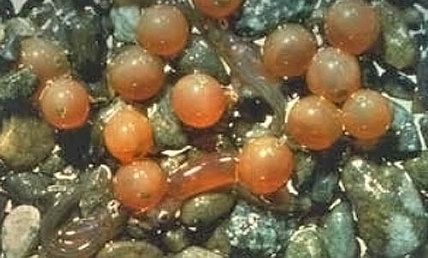
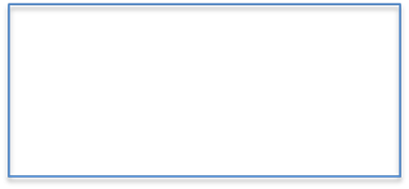
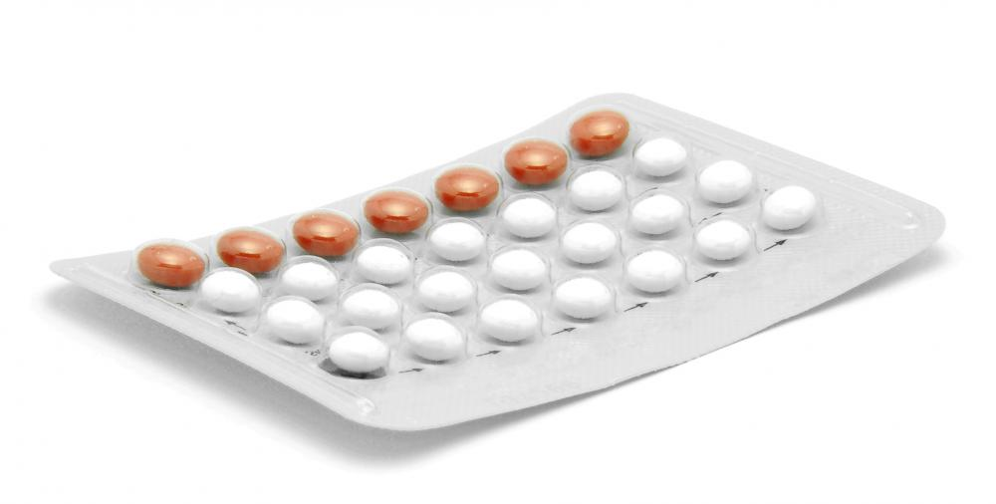
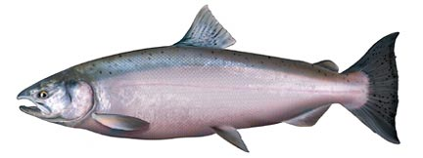
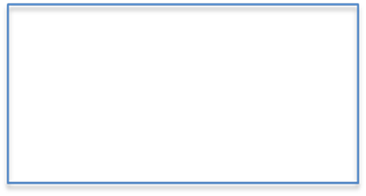
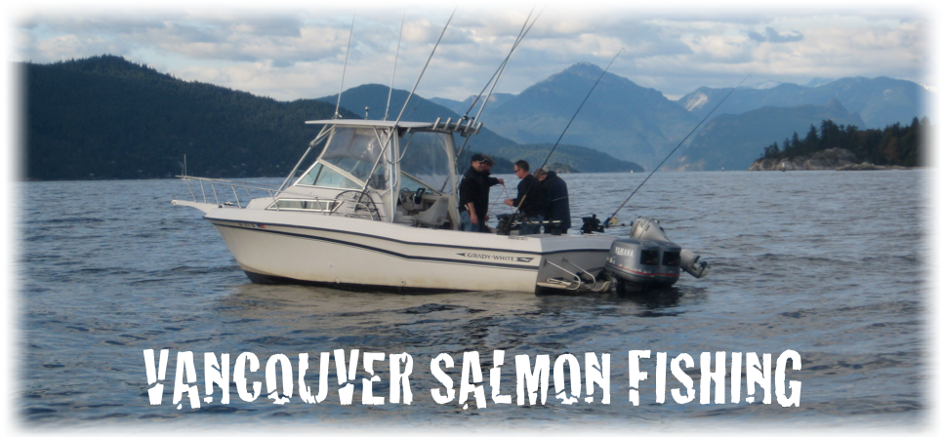
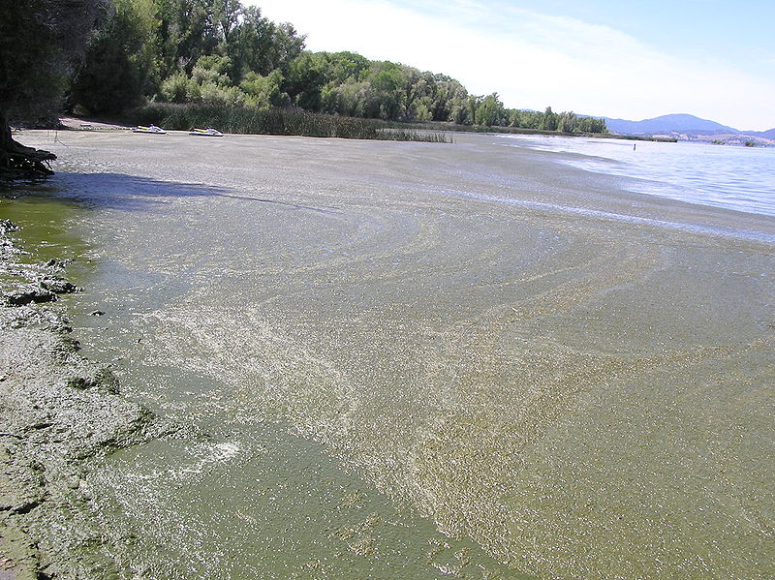
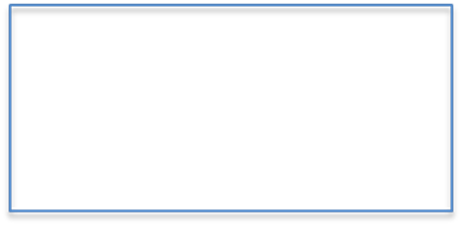

Problem Formulation
Source: Pebble Science’s Salmon Ecology
Source: Wisegeek.com
Source: ChromerSportFishing.com
Source: News.discovery.com, taken by Tim Wall:
Risk Assessment Problem: Are wild salmon stocks in danger of reduced fecundity relating to the use of Synthetic Estrogens along the Fraser River?
Source: West Coast Expeditions
Notes:
-Traces of Ethinylestradiol (EE2) can be found in the Fraser River due to seepage from wastes (discarded birth control pills)
-Contraceptive pills contain an average of 30 ug EE2, and 26% EE2 excreted in urine.
-Resource Management and Risk Assessment Problem: What is maximum “safe” concentration level of EE2 found in Fraser River water inflows that will not jeopardize Pacific Salmon reproductive health?
-We want to find the maximum safe concentration level of EE2 in the Fraser river, taking into account population growth, and everything was held constant.
-

Slide 3
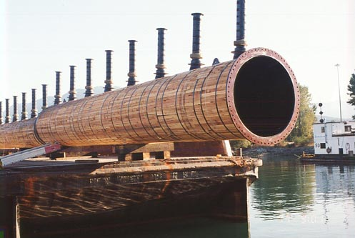
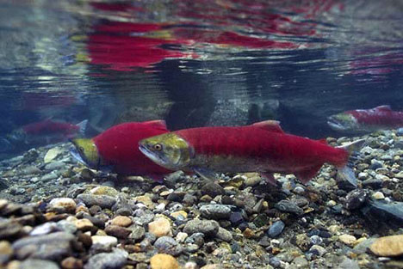
Exposure
Source: Wisegeek.com
Source: Opus DaytonKnight Outfall Systems
Source: deltaphiltdic Blog
Chemical Input = (Female Population) * (% using Oral Contraceptive) * (Chemical per Pill) - (Amount of Chemical Excreted) - (Amount Removed at WWTP)
Input is on a daily basis, converted to kg/year for input into Level 3 Fugacity model
Between 3.113 kg/year and 0.7180 kg/year being released into the water via waste water effluent
Notes:
Waste water effluent is then dumped into the Fraser River after treatment and the EE2 in this effluent contaminates the water, exposing returning and leaving salmon to the chemical
http://www.dayton-knight.com/projects/wwtp/outfall_systems.htm
http://detlaphiltdic.blogspot.ca/2010/09/once-in-century-salmon-run-hits-canada.html

Slide 4
Toxicity Data (LOEC)
Fish Species | Concentration (ng/L) | Time Interval (days) | Endpoint | Reference
Rainbow Trout | 16.0 | 62 | Embryo development potential | Schultz et al. (2001)
 | 2.0 | 21 | Reduced gonad-body weight ratio | Jobling et al. (1996)
 | 1.0-7.6 | 14 | Estrogenic activity (VTG induction) | Thorpe et al. (2003)
Sheepshead minnow-marine | 20.0 | 59 | Production; hatch; 7 day fry-survival; semen quality | Zilloux et al. (2001)
 | 200.0 | 43 | Production; hatch; 7 day fry-survival; semen quality | Zilloux et al. (2001)
Guppy | 112 | 108 | Reproduction; sex ration in male guppy | Kristensen et al. (2005)

Slide 5
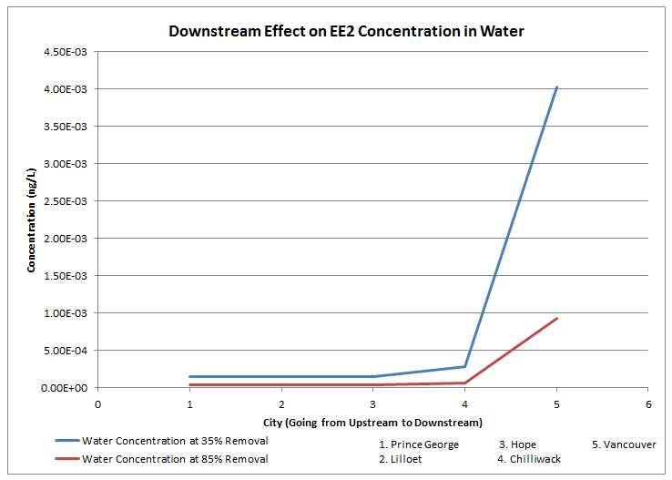
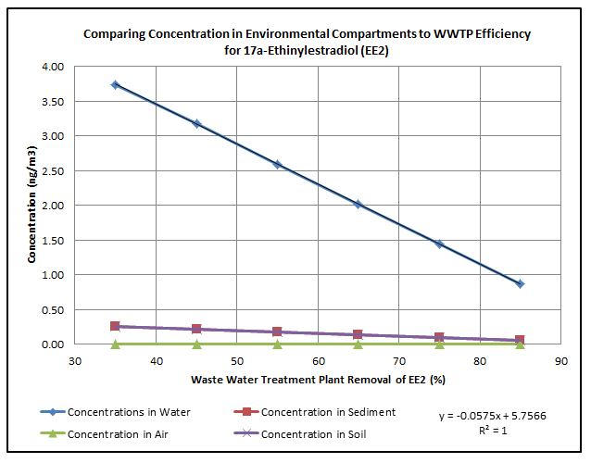
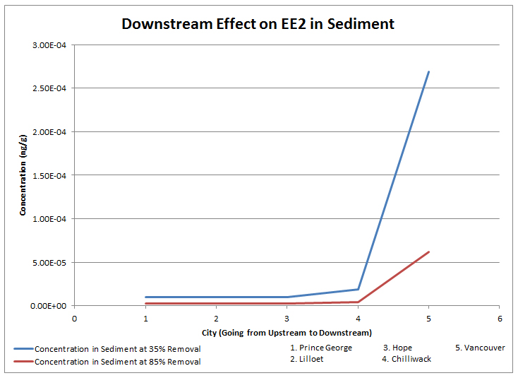
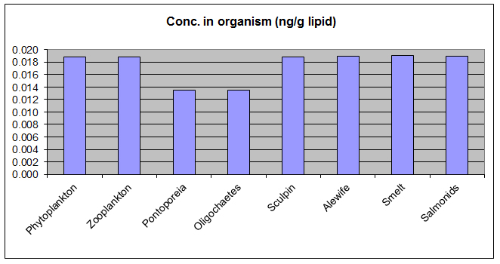
Risk Characterization
Notes:
This shows that the dominant compartments are Water and Sediment. Air and soil are negligible.
The model was run assuming zero emissions to Air, Soil, and Sediment.
These graphs show that Vancouver dominates the input of EE2 into the environment. It is located at the mouth of the Fraser River and is the first exposure of Returning Salmon to the chemical and as new Salmon leave for the ocean, they experience greater concentrations as they travel back to Vancouver.
These two graphs, combined with the first graph that illustrates the relationship between WWTP efficiency and resulting water concentrations, shows that Vancouver is a critical point on the Salmon Run. Improving WWTP handling of EE2 to 85% removal could significantly reduce the concentration of EE2 in the water. This can be done by retrofitting the WWTPs to focus more on estrogenic chemical removal processes.
The water concentrations, however, low still do not account for the effects of bioaccumulation of EE2. This will be analyzed via a Foodweb Model.
Additionally, and interestingly, the Bioaccumulation model showed that, once the data output was standardized, there did not appear to be a bioaccumulative effect.
WQG set by BC is 0.5 ng/L
Our model is 0.6% of that concentration given the emmissions we used. Inputs to soil and sediment can both increase the concentration, as can a population increase for an increase in the percentage of women using contraceptives.
However, it is important to note the the Lowest Detectable Amounts that most labs in BC can accommodate is 5 ng/L, 100 times the WQG concentration. There is a very real possibility that water concentrations could exceed the WQG without detection.

Slide 6
Uncertainty
Contextual Factors | Model Assumptions | Data Gaps
- Chemical input represents daily real life use | - Level 3 Fugacity Model (does not assume equilibrium & steady state, contained 4 compartments) | -Trout approximate salmon
- Reported birth control use represents birth control use in Vancouver, city 1 and city 2; birth control trends are the same across cities | - Volatization is negligible due to low Henry Law Constant - No degradation between cities - Emissions only to water | - LOEC data was used, Endpoints considered chronic, no safety factor applied
- Output concentrations become background concentrations for the next city | - Half-life data drawn from literature | - Used endpoint values in ranged data for conservative and liberal estimates
Notes:
-Level 3 Fugacity Model: representative of the Fraser River Area, contained 4 compartments (Air, Water, Soil, Sediment)
-Trout approximate salmon (growth rates similar, trout also native to Fraser area, Pacific Salmon and Trout are in the same genus)
assumptions include relative half-life lengths, similar degradation processes between suspended sediment and water
-no Safety Factor applied due to direct comparison
-Data was scarce and variable therefore assumed the largest and smallest values represented a valid range for parameters for conservative and liberal estimates
-No safety factor for direct comparison
-Assuming that output concentration become background concentrations for the next city (no degradation between cities)

Slide 7
References
British Columbia Stats.(June 2012). Population Projections. Retrieved from
http://www.bcstats.gov.bc.ca/StatisticsBySubject/Demography/PopulationProjections.aspx
This source provided demographic information on the different populations that were used in the level 3 fugacity model.
Cargouet M., Perdiz D., Mouatassim-Souali A., Tamisier-Karolak S., Levi Y. (2004). Assessment of river contamination by estrogenic compounds in Paris area (France). Science of the Total Environment 324, 55–66.
This source provided a viable framework that allowed conditions in Paris to be compared to settings in Vancouver. Paris essentially served as the model city used in our calculations and data. It also provided the necessary values we need to assess bioaccumulation in the fish.
Chemcan Level 3 fugacity model (2012). Retrieved from Tao Eastham.
Provided the model program that allowed us to input our data and generate results for EE2 concentration in the Fraser River.
Chemspider (2012). 17a-Estradiol. Retrieved from http://www.chemspider.com/Chemical-Structure.61840.html?rid=ac63e4e0- b93f-4d87-b0e7-88ac635a4ff8
This database provided the chemical properties of EE2, including, Kow, melting point, water solubility, Henry Law Constant, molecular mass, and vapor pressure.
Cirja M., Zuehlke S., Ivashechkin P., Hollender J., Schaffer A., Corvini P. (2007). Behavior of two differently radiolabelled 17a- ethinylestradiols continuously applied to a laboratory-scale membrane bioreactor with adapted industrial activated sludge. Water Research 41, 4403– 4412.
From this paper we were able to establish the causes of high levels of EE2 in water systems and how they affect the reproductive system of fish.
Farley E., Trudel M. (2009).Growth Rate Potential of Juvenile Sockeye Salmon in Warmer and Cooler Years on the Eastern Bering Sea Shelf. Journal of Marine Biology, Article ID 640215,10 pages.
This source provided growth rates for young Sockeye Salmon

Slide 8
References
Feng Y., Zhang Z., Gao P., Su H., Yu Y., Ren N. (2010). Adsorption behavior of EE2 (17_-ethinylestradiol) onto the inactivated sewage sludge: Kinetics, thermodynamics and influence factors. Journal of Hazardous Materials 175, 970–976.
Provided information on maximum levels of EE2 in wastewater treatment plants
Fisheries and Oceans Canada (2008). Aquatic Species at Risk - Coho Salmon (Interior Fraser River).
From this website we were able to collect data on the physical attributes and morphological composition of Coho salmon.
Gregory R., Wood C. (1998). Individual Varitiation and Interrelationships between Swimming Performance, Growth Rate, and Feeding in Juvenile Rainbow Trout (Oncorhynchus mykiss). Canadian Journal of Fisheries and Aquatic Sciences, 55(7), 1583-1590.
This source provided the growth rates of both rainbow trout and sockeye/coho salmon in order to establish their relationship and make a valid assessment of toxicity in pacific salmon.
Khanal S., Xie B., Thompson M., Sung S., Ong S.K., Van Leeuwen J. (2006). Fate, Transport, and Biodegradation of Natural Estrogens in the Environment and Engineered Systems. Environmental Science and Technology, 40(21), 6537- 6546.
This source detailed the different forms of estrogen, as well as the sources of estrogen from the evaluative environment. The paper described the different ways of removing free estrogen from the environment and the necessary precautions that needed to be made.
Larsson D., Adolfsson-Erici M., Parkkonen J., Pettersson M., Berg A.H.,Olsson P.E., Forlin L. (1999). Ethinyloestradiol – an
undesired fish contraceptive? Aquatic Toxicology 45, 91–97.
This paper provided the foundation for our toxicity (LOEC) research. Rainbow trout toxicity data and its associated threshold for toxicity were extracted.

Slide 9
References
Miller J.A., Simenstad C.A. (1995). Growth of Juvenile Coho Salmon in Natural and Created Estuarine Habitats: A Comparative Study using Otolith Microstructure Analysis.
This source provided the growth rates for young Coho Salmon.
Nagpal N., Meays C. (2009). Water Quality Guidelines for Pharmaceutically-active-Compounds (PhACs): 17α-ethinylestradiol (EE2). This data extracted from this paper were used to devise a feasible for water quality guideline for EE2
Pacific Angler (2012). BC Salmon Identification Chart. Retrieved from http://www.pacificangler.ca/bc- fishinginfo/salmonidentification-chart.html
This source was useful in providing data for the receptors, as well as linking Rainbow Trout to Coho/Sockeye Salmon via morphology.
Qiming C., Qiming Y., Connell D. (2010). Fate stimulation and Risk Assesment of Endocrine Disrupting Chemicals in Reservoir Receiving Recycled Wastewater. Science of the Total Environment, 408, 6243-6250.
This source provided the half-lives for EE2 in different mediums, which we used in the level III fugacity model.
The Nature Conservancy. (2007). The Gonadosomatic Index. Retrieved from
http://www.reefresilience.org/Toolkit_FSA/F3a3_GonadIndex.html
This website carried useful information expounding the reproductive systems for a variety of different fish species, and included the ratio of fish gonad weight to body weight for pacific salmon and rainbow trout.

Slide 10
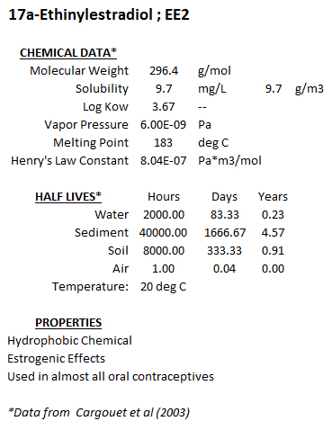
Chemical Properties

Slide 11
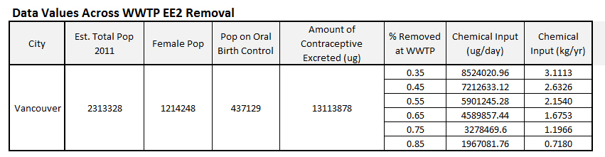
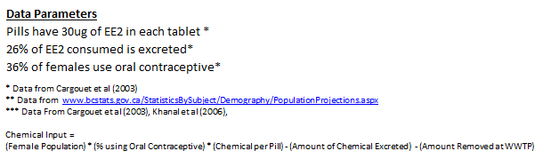
Removal Rate Comparison Inputs

Slide 12
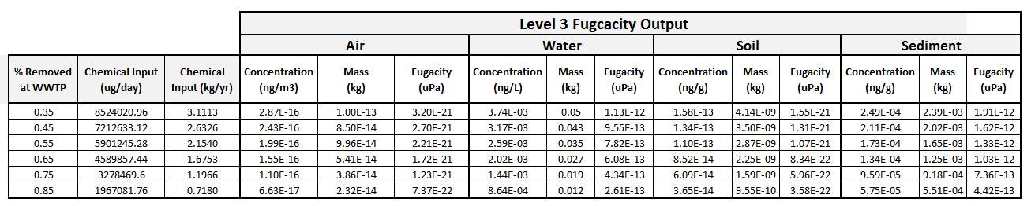
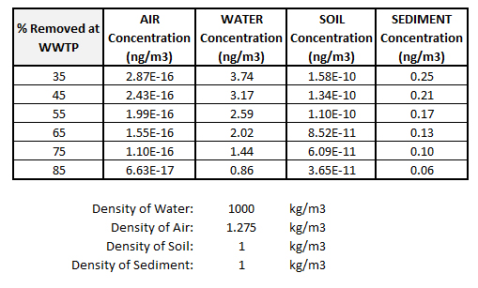
Level 3 Fugacity Model Removal Comparison Output

Slide 13
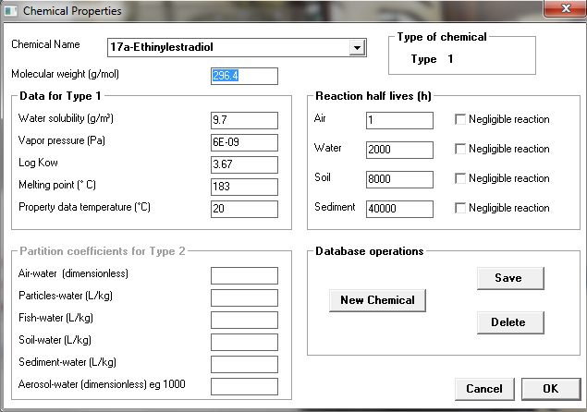
Model Inputs

Slide 14
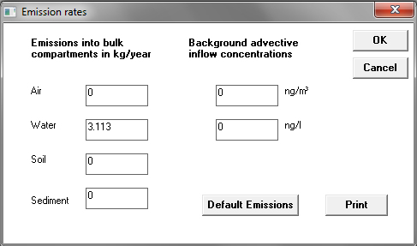
Model Inputs

Slide 15
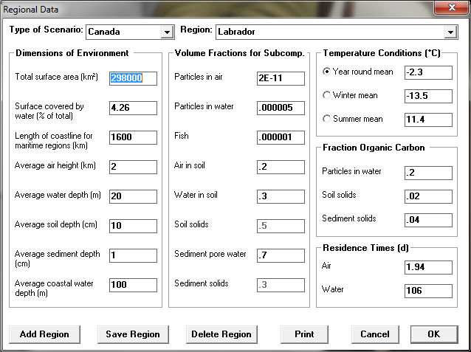
Model Inputs

Slide 16
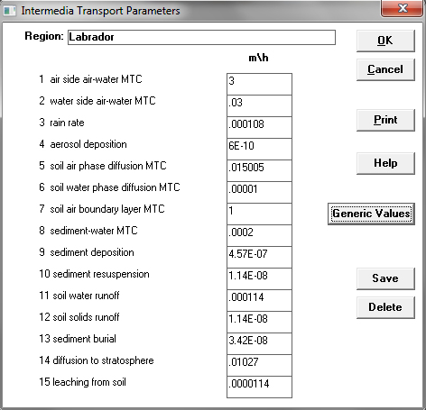
Model Inputs

Slide 17
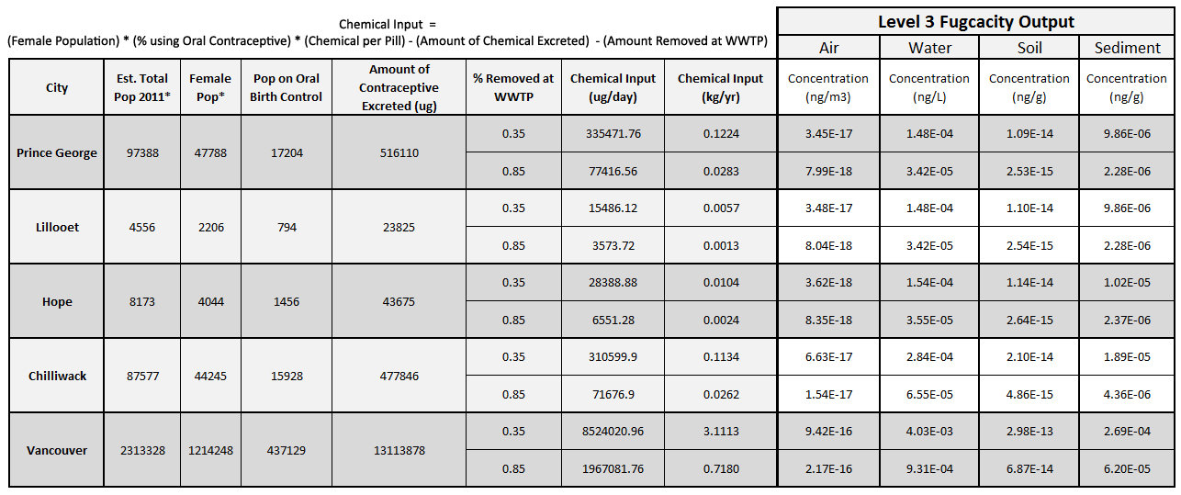
Comparison Across Cities

Slide 18
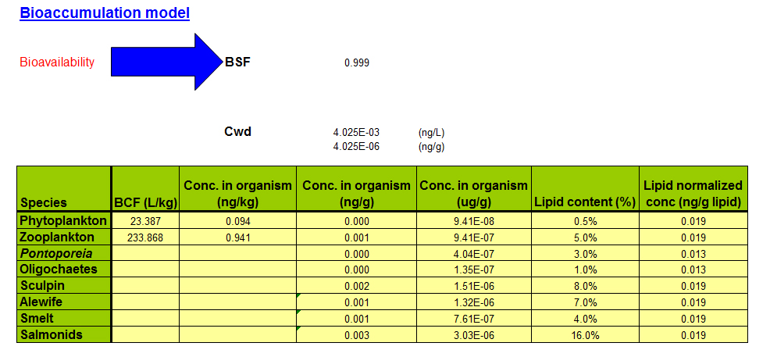
Foodweb Model Results

Slide 19
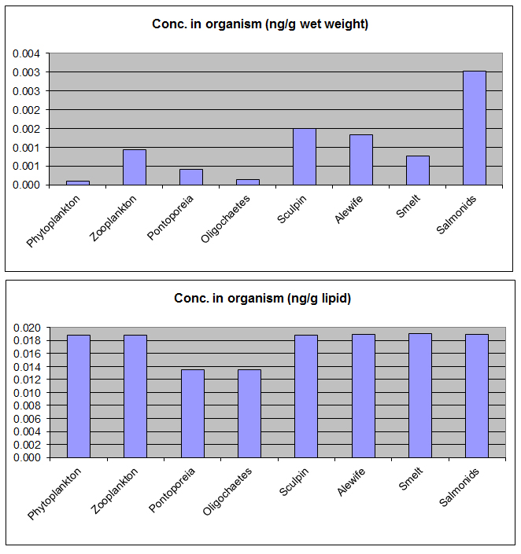
Foodweb Model Results

